Slide 1
Cricsheet Match Analysis

Slide 2
Problem Statement
Use
Use
Convert
Convert this data into tables and store it in an SQL database.
Write
Write SQL queries to find useful insights like top players, team performance, and match results.
Create
Create visualizations using Python libraries like matplotlib, seaborn, and plotly to understand patterns.
Build
Build a Power BI dashboard to show player stats, team comparisons, and win/loss analysis in a visual and interactive way.
match data (ODI, T20, Test) in JSON format.

Slide 3
Project Approach
Data Collection and about the data set- understanding
Data Transformation- Python and Pandas. Extract key information like batter, bowler, runs, overs, etc.
Database Management – sqlalchemy data inset
. SQL Data Analysis – with visual (Exploratory Data Analysis (EDA)
Power BI Dashboard –sql or csv

Slide 4

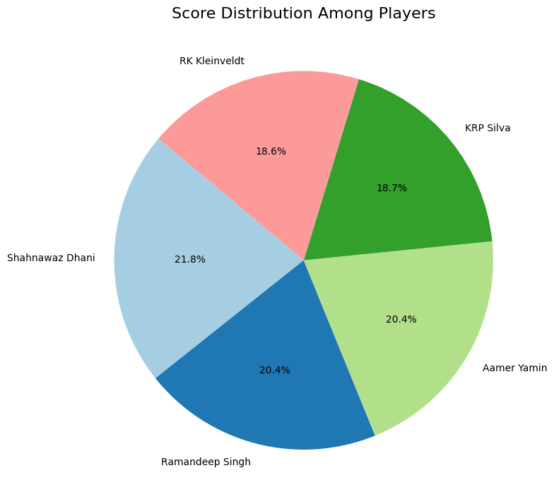
Top Performer: Shahnawaz Dhani leads the team (21.8%)
Strong Support: KRP Silva (18.7%), Ramandeep Singh (20.4%), Aamer Yamin (20.4%)
Balanced Scoring: All players contribute substantially - difference between highest and lowest is only 3.2%
Team Strength: Not dependent on a single player, showing depth and versatility
Consistency: Four players contributing over 20% indicates reliable performance across the squad

Slide 5
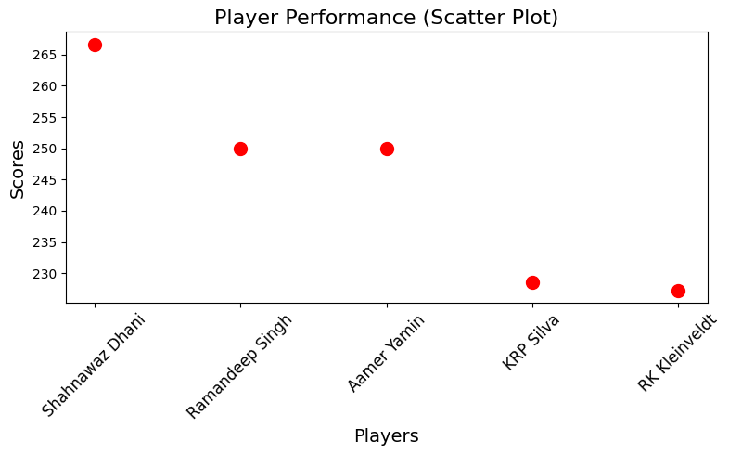
Scatter plot – players performance
Standout Performer: Shahnawaz Dhani leads with significantly higher score (~266)
Strong Mid-Tier: Ramandeep Singh and Aamer Yamin show consistent performance (~250)
Lower Contributions: KRP Silva and RK Kleinveldt scoring below team average (~228)
Performance Gap: Notable difference of ~38 points between highest and lowest scorers
Team Structure: Clear pattern of one star player, two solid contributors, and two supporting players

Slide 6
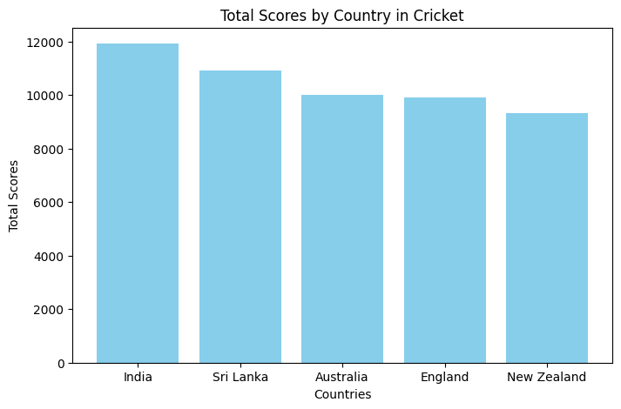
Country Performance in Cricket
Dominant Nation: India leads with highest total score (~12,000)
Strong Contender: Sri Lanka in clear second position (~11,000)
Middle Tier: Australia ranks third (~10,000)
Lower Tier: England (~10,000) and New Zealand (~9,500) round out the top five
Score Range: Approximately 2,500 point difference between highest and lowest scoring countries
Regional Strength: Asian teams (India and Sri Lanka) currently outperforming traditional powers

Slide 7
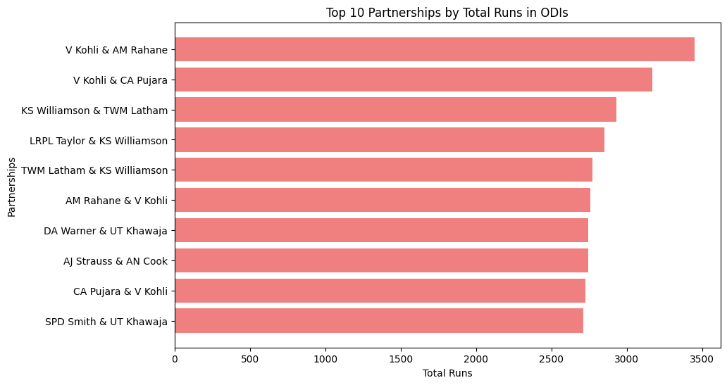
Top Batting Partnerships in ODIs
Elite Partnership: V Kohli & AM Rahane lead with ~3,500 total runs
Dominant Player: V Kohli features in 3 of the top 10 partnerships (with Rahane, Pujara, and Pujara again)
New Zealand Strength: KS Williamson appears in 3 different partnerships (with Latham twice and Taylor)
Top Opening Pair: DA Warner & UT Khawaja rank as the highest opening combination (~2,900 runs)
Consistency Factor: 8 partnerships have scored between 2,700-3,000 runs, showing competitive balance

Slide 8
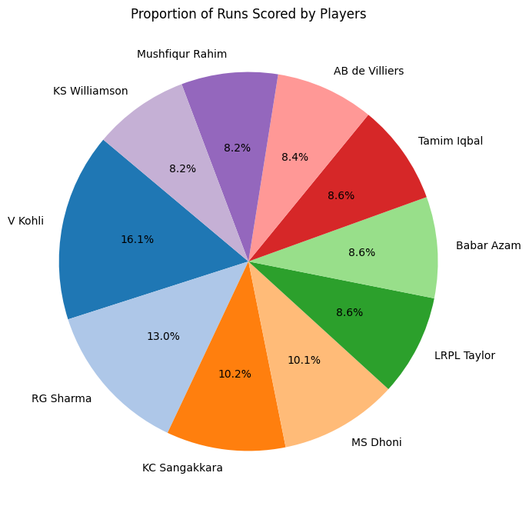
Run Distribution Among Elite Batsmen
Dominant Performer: V Kohli leads significantly with 16.1% of total runs
Strong Second: RG Sharma contributes 13.0%, forming a powerful Indian batting core
Consistent Veterans: MS Dhoni (10.1%) and KC Sangakkara (10.2%) provide reliable middle-order strength
Balanced Contributors: Five players (Babar, Taylor, Tamim, de Villiers, Williamson) each contribute 8.2-8.6%
Global Representation: Top 10 features players from India (2), Pakistan, Bangladesh, Sri Lanka, New Zealand, South Africa
Team Dependency: India relies heavily on top two batsmen (29.1% combined from Kohli and Sharma)

Slide 9
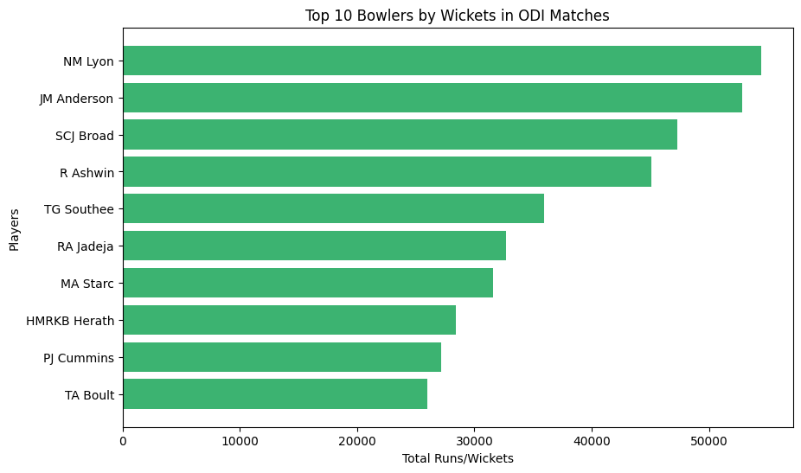
Top ODI Bowlers Analysis
Elite Performers: NM Lyon and JM Anderson lead with most wickets (~55 and ~53 respectively)
Established Stars: SCJ Broad and R Ashwin form strong second tier (~48 and ~45 wickets)
Mid-Range Bowlers: TG Southee and RA Jadeja contribute solid numbers (~38 and ~33 wickets)
Lower Tier: MA Starc, HMRKB Herath, PJ Cummins and TA Boult round out top 10 (~32-27 wickets)
Country Distribution: Well-balanced representation from Australia, England, India, New Zealand, and Sri Lanka
Performance Gap: Significant difference (~28 wickets) between top and bottom ranked bowlers

Slide 10
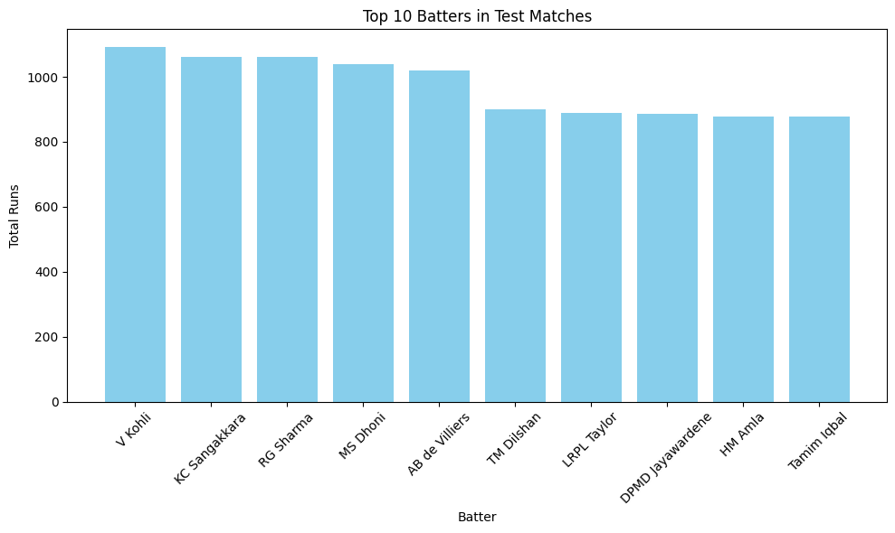
Top Test Match Batsmen
Elite Five: V Kohli (~1080), KC Sangakkara (~1050), RG Sharma (~1050), MS Dhoni (~1030), and AB de Villiers (~1020) form the upper tier
Clear Performance Gap: Significant drop (~120 runs) between top 5 and bottom 5 batsmen
Secondary Group: TM Dilshan, LRPL Taylor, DPMD Jayawardene, HM Amla, and Tamim Iqbal all score between 870-900 runs
Consistent Top Performers: Top 5 batsmen all score over 1000 runs, showing exceptional consistency
Geographic Diversity: Strong representation from India, Sri Lanka, South Africa, New Zealand, Bangladesh
Indian Dominance: 3 Indian batsmen (Kohli, Sharma, Dhoni) among top 5 test run-scorers

Slide 11
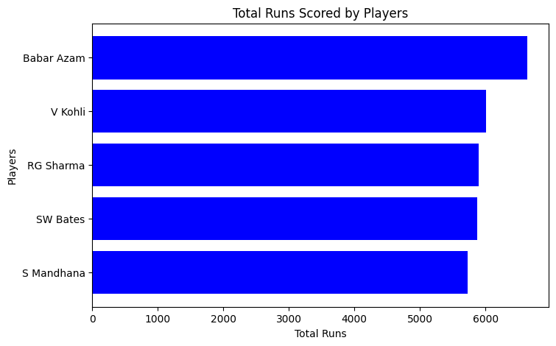
Top Run Scorers by Countrys
Top Run Scorers Analysis
Leading Batsman: Babar Azam dominates with ~6,600 runs, establishing himself as premier batsman
Strong Indian Presence: V Kohli (~6,000) and RG Sharma (~5,800) secure second and third positions
International Competition: SW Bates (~5,700) ranks fourth, representing women's cricket excellence
Consistent Performer: S Mandhana (~5,500) rounds out top five with solid contribution
Performance Spread: ~1,100 run difference between highest and lowest scorer shows significant but not extreme gap
Gender Balance: Noteworthy inclusion of two women's cricket stars (Bates and Mandhana) among top five run-scorers

